Slide 1
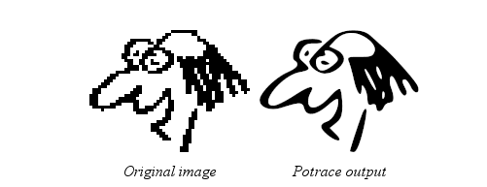
POTRACE
1
Bitmap -> Vector

Slide 2
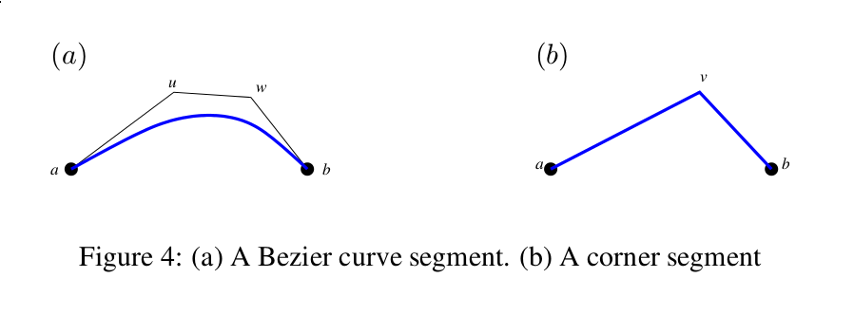
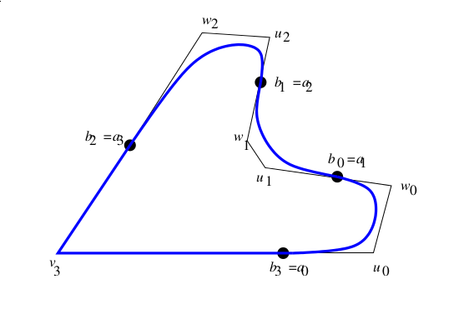
2
Handle (Control Point)
Point (End point)
Bezier Curve Segment
Corner Segment
Path

Slide 3
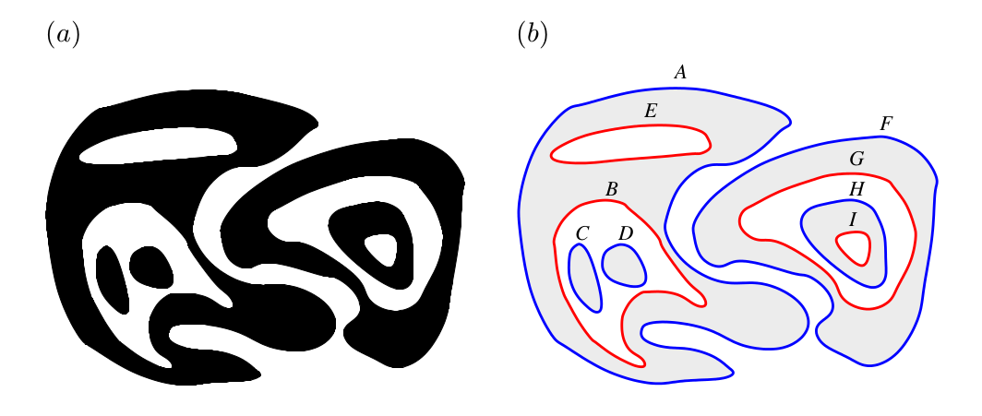
3
‘+’ - Blue
‘-’ - Red

Slide 4
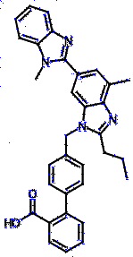
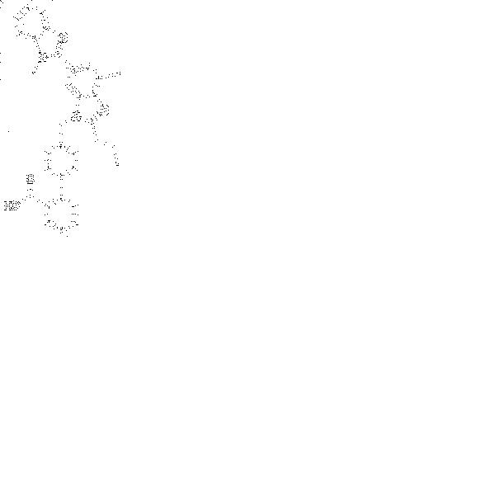
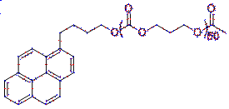
4
All points (handles and points)
Points - Red
Handles - Blue

Slide 5
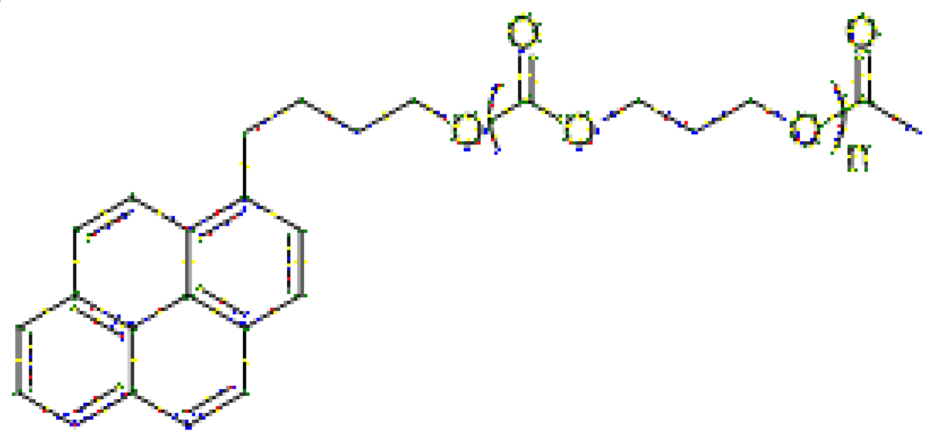
5
Corner Points - Yellow
Corner Handles - Green
Curve Points - Red
Curve Handles - Blue

Slide 6
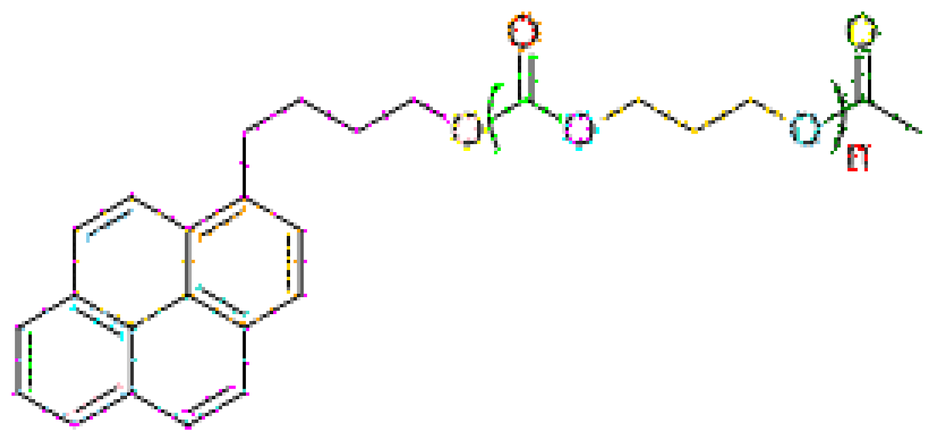
6
Each connected path gets a unique color.

Slide 7
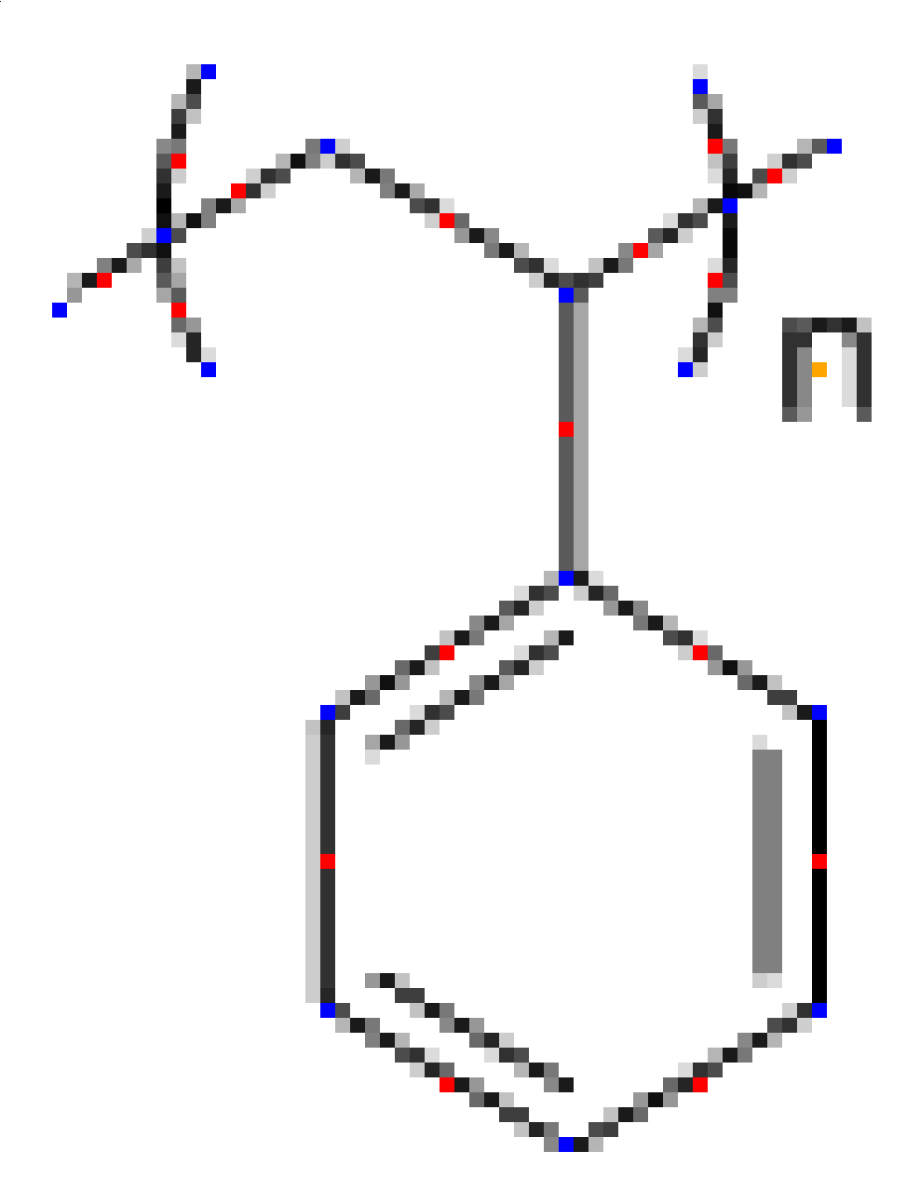
7
Red - Bond midpoint
Blue - Atom
Orange - Character

Slide 8
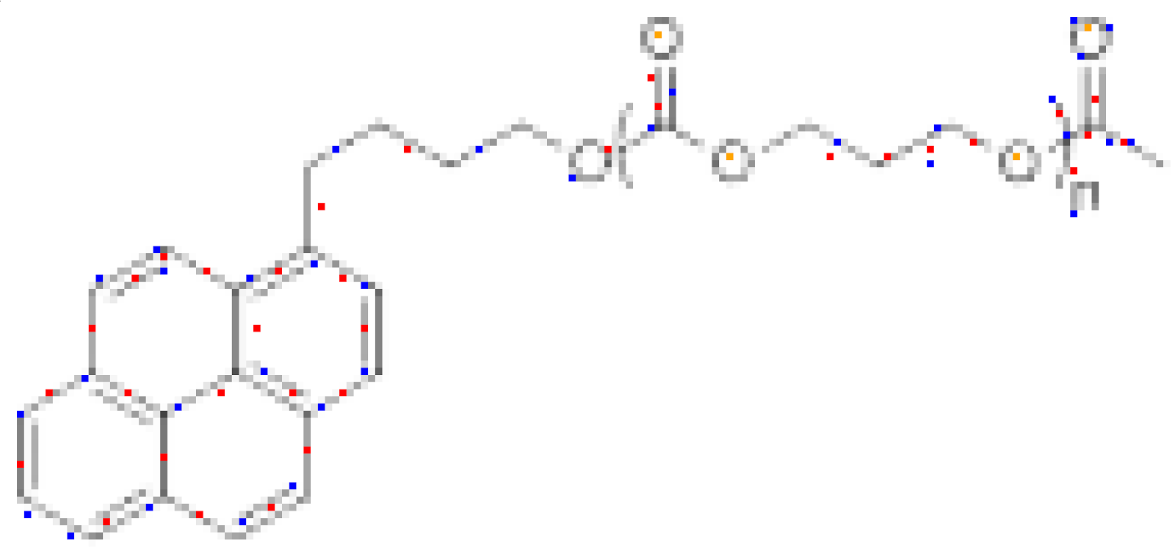
8

